Slide 1
Document Verification
Shailja 19bce1454
Aditya 19bce1402
Pankaj 19bce1642

Slide 2
OBJECTIVE
The objective of this project is to attempt to inject a bit of automation in the process of document verification which in real life is a pretty cumbersome process.Just to set the wheels of the system in motion,the document we will be looking at is our college ID Card.The larger objective of this system is to be able to verify official documents such as Aadhar Card,Pan Card etc.The objective of this system is to not only to verify a document but to verify the CORRECT document

Slide 3
Problem Statement
We all have come across the official procedure for renewing a passport in India. We are required to upload a soft copy of the documents and then show the same documents in the form of a hard copy to the passport office. The same procedure is more or less followed for getting KYC(Know your customer) done. All this is a pretty cumbersome process. In our project, we wanted to inject a bit of automation into this process. Since most verifications in India require the Aadhar card, our system was originally targeted towards the Aadhar Card. Due to time and computational constraints, we decided to create a system which can first verify VIT Chennai ID Cards and then maybe as an expansion can then verify official government documents like PAN,Aadhar Card

Slide 4
METHODOLOGY
STEP 1: Dataset
STEP 2: Extracting Region of Interest
STEP 3: Training a Object Detection Model on ID Card
STEP 4: Extracting Data using OCR
STEP 5: Validation of Data extracted using OCR

Slide 5
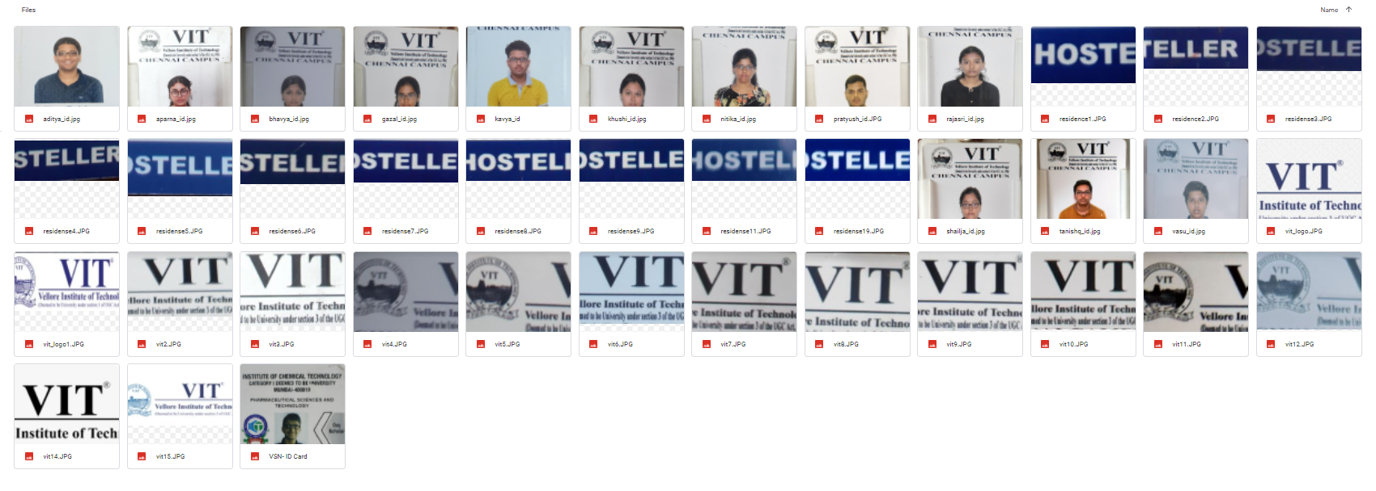
STEP 1: Dataset

Slide 6
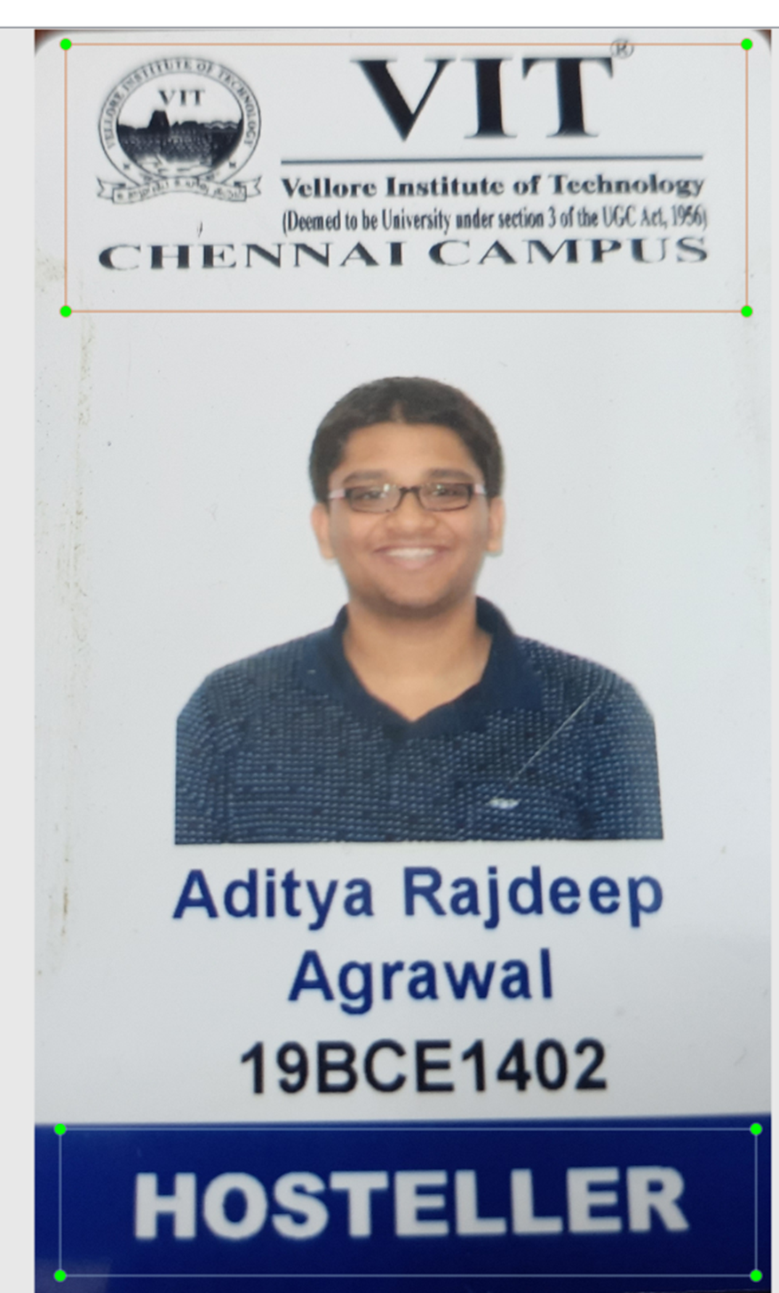
STEP 2: Extracting Region of Interest
After extracting the Region of Interest, feature extraction, and object recognition technology will be applied, and features specific to the ID card will be detected and marked.
In the above image, the green boxes indicate the features based on which the verification of the ID Card will be done
First green box-College Logo
Second green box-Residence Status

Slide 7
STEP 3: Training a Object Detection Model
Step I: Collect a comprehensive dataset concerning the ID card.
Step II: After creating a dataset, we need to label it.
Step III: Now, all prerequisites are ready we will train our model
Since we did not have a lot of images to train our model, we decided to lower the threshold for identifying the boxes to 30% from 60%.We gave 2 sets of images to the pretrained model (test and train) for training purpose and a used a third test(eval) for validation of the trained model. The test images were used to help in calculating the loss function which is a metric for measuring the reliability of the trained model

Slide 8
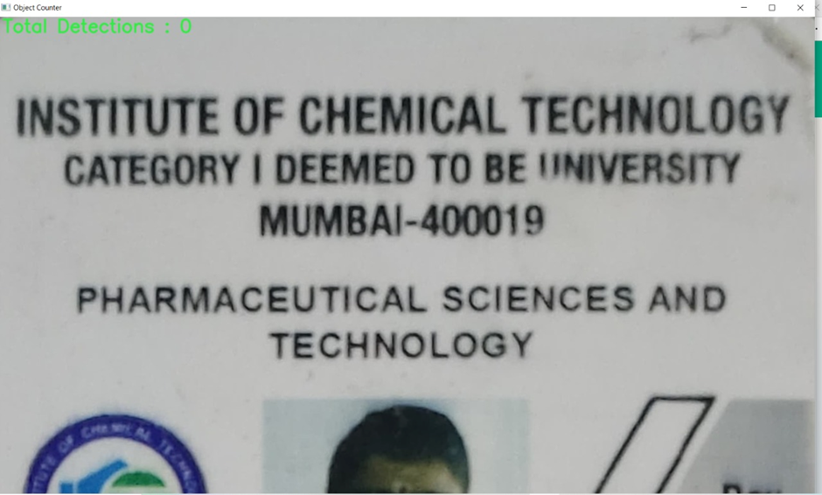
STEP 4: Verification of Document
For the purpose of our system, we will be feeding the training and testing images to a pretrained model and configure it accordingly. We will then use the pretrained model to verify whether the given ID card belongs VIT Chennai. The ID cards belonging to VIT Chennai were then stored in the Windows File System. The entire directory consisting of all the verified ID Cards is read by the OCR program.Since the above card does not belong to VIT Chennai, the object detection model could not identify a single feature and therefore the above ID Card was not sent for OCR Verification.

Slide 9
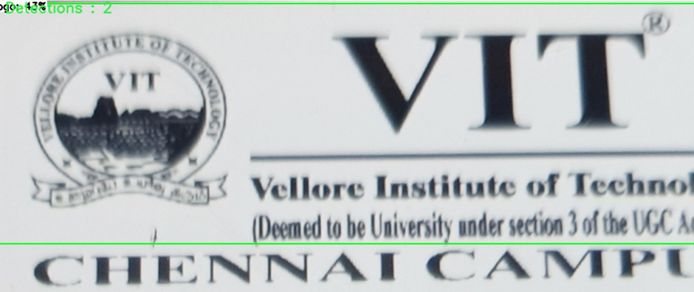
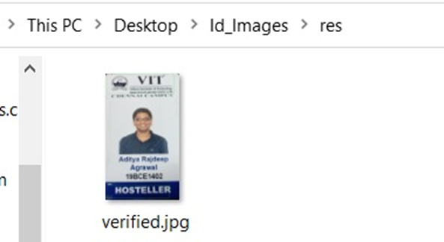
The picture shows the directory in which the verified image was stored after the object detection process by the TensorFlow API

Slide 10
STEP 5: Extracting Data using OCR
After it is verified that the submitted document is an ID card then information present on ID will be extracted by the means of Optical Character Recognition (OCR). That program extracts the Register No and Residence Status from the text given in the ID Card and compares it with the records in the Database
Registration number :- XXXXXXXXX
Residence Status :- XXXXXXXX

Slide 11
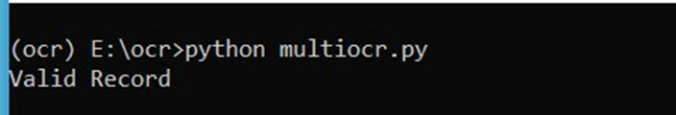
STEP 6: Validation of Data extracted using OCR
This information will be processed and validated by using an existing database. Registration number, Accommodation detail will be verified by comparing it with customer records available in the database.
Since the above card belongs to VIT Chennai, the object detection model identified and therefore the above ID Card was sent for OCR Verification. The OCR verified the Register No and residence status from the database and confirmed the validity of the ID Card

Slide 12
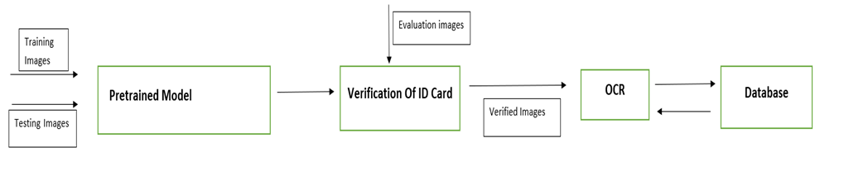
Proposed System

Slide 13
Conclusion
The object detection model worked well enough to differentiate between VIT and Non-VIT ID cards. One problem we faced was that the object detection model couldn’t take multiple evaluation images as input and we had to manually feed different images. As an extension of the problem just mentioned, we had to delete the verified image after one iteration of the system so that for the subsequent iterations, the directory where the verified ID cards are stored is empty.

